Slide 1
Mobile Computing
Introduction to wireless communication system

Slide 2
On the way communication
Evolved since 1897 by Marconi’s radio demonstration.
Mobile radio communication industry is growing by order of magnitudes.
Fueled by digital and miniaturization technologies.
Cellular N/W and Personal Communication Services (PCS)

Slide 3
Contd...
Cellular concept was developed Bell Laboratories in the 1960s and 1970s
Wireless Communication era begun in the year of 1970 with the development of highly reliable miniature, solid-state RF h/w.
AM -> FM
The future is related to radio spectrum allocations and regulatory decisions

Slide 4
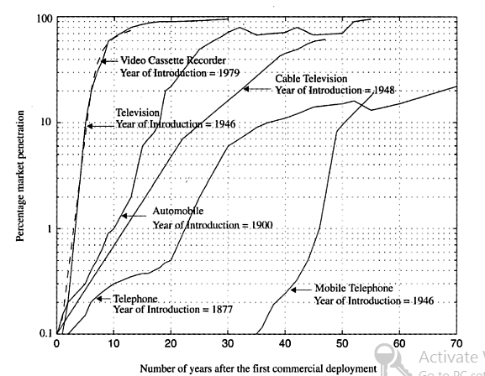
Market Penetration Data

Slide 5
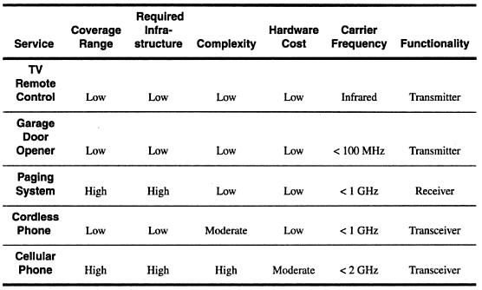
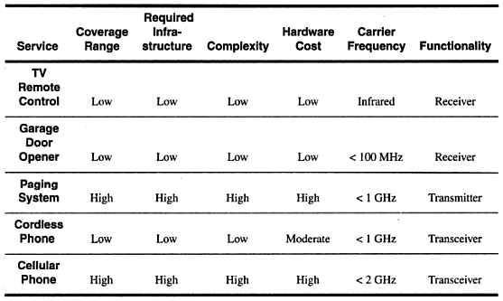
Mobile Communication Devices
Mobile Station
Base Station

Slide 6
Mobile Telephones
First public mobile telephone service in 1946.
Cellular radiotechnology during 1950s and 1960s
First US Cellular Phone System- AMPS-1983
USDigital Cellular System-1991

Slide 7
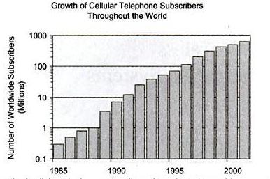
Cellular Communication
Explosive growth since the mid of 1990s.
Subscription increase of 40% or more per year.
A viable, robust voice and data transport mechanism.

Slide 8
2G Cellular Network
First Generation
Analog
AMPS,ETACS, JTACS
Relied on FDMA/FDD and analog FM
Second Generation
Introduced in the early 1990s.
Digital Modulation formats and TDMA/FDD & CDMA/FDD multiple access techniques.
Notes:
F,T,CDMA-Frequency, Time, Code Division Multiple Access. FDD-Frequency Division Duplex
E, JTACS- Extended, Japaneses Total Access Communications System

Slide 9
2G Standards
TDMA Standards
Global System Mobile (GSM)
Supports 8 time slotted users for each 200 kHz radio channel.
Europe, Asia, Australia, South America & Some parts of US
North American Digital Cellular (NADC), Interim Standard 136 (IS-136)
Supports 3 time slotted users for each 30 kHz radio channel.
North America, South America, Australia
Pacific Digital Cellular (PDC)
Japanese Standard similar to IS-136
CDMA
Interim Standard 95 (IS-95) (CDMA one)
Supports 64 users that are orthogonally coded and simultaneously transmitted on each 1.25 MHz channel.
North America, Korea, Japan, China, South America & Australia

Slide 10
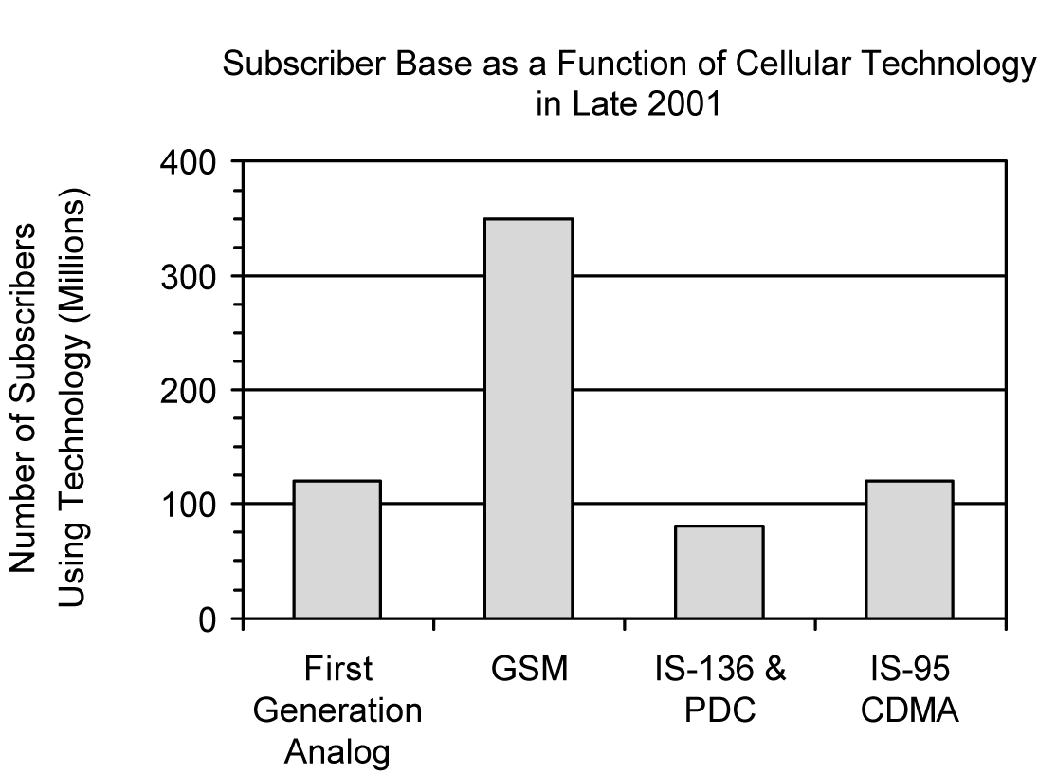
Worldwide Subscriber base as a function of cellular technology in late 2001

Slide 11
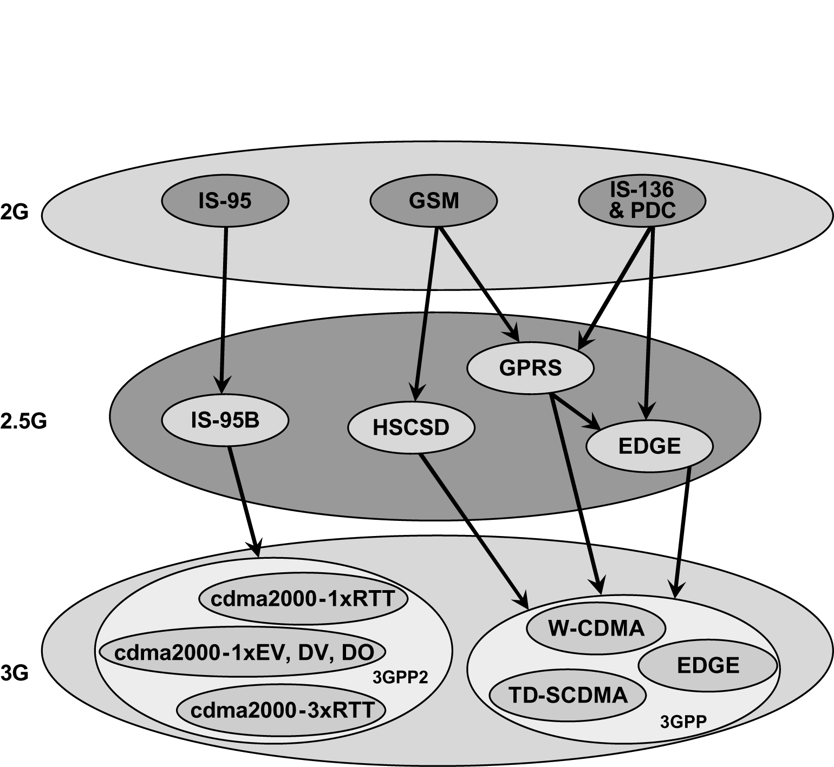
Various Upgrade paths for 2G Technologies

Slide 12
2.5G TDMA Standards
The three TDMA upgrade options include
High Speed Circuit Switched Data (HSCD)
General Packet Radio Service (GPRS)
Enhanced Data Rates for GSM Evolution (EDGE)

Slide 13
High Speed Circuit Switched Data (HSCD) for 2.5 GSM
A circuit switched technique
Allows a single mobile subscriber to use consecutive user time slots in the GSM standard.
Increased application data rate to 14400 bps as compared to the original 9600 bps in the GSM specification.
Able to provide raw transmission rate upto 57.6 kbps by using upto 4 consecutive time slots.
Notes:
.instead of limiting each user to only one specific time slot in the GSM TDMA standard.
. Billed as a premium service by the carrier.

Slide 14
High Speed Circuit Switched Data (HSCD) for 2.5 GSM
HSCSD is ideal for dedicated streaming Internet access or real-time interactive web sessions.
Simply requires the service provider to implement a software change at existing GSM base stations

Slide 15
GPRS for 2.5 GSM and IS-136
General Packet Radio Service (GPRS) is a packet-based data network.
Well suited for non-real time internet usage
Retrieval of email and web browsing where the user downloads much more data than it uploads.
Supports multi-user network sharing of individual radio channels and time slots
HSCSD, dedicates circuit switched channels to specific users
GPRS can support many more user than HSCSD, but in a bursty manner.

Slide 16
GPRS for 2.5 GSM and IS-136
Provides a packet network on dedicated GSM or IS-136 radio channels.
Retains the original modulation formats that of 2G TDMA standards.
Instructed to tune to dedicated GPRS radio channels and particular time slots for always on access.

Slide 17
GPRS for 2.5 GSM and IS-136
Achives transmission rate upto 171.2 kbps (21.4*8)
Throughput decreases as more users attempt to use the n/w or as propagation conditions become poor.
The channel rate works well with both GSM and IS-136

Slide 18
EDGE for 2.5 GSM and IS-136
Enhanced Data rates for GSM Evolution is a more advanced upgrade to the GSM standard.
Requires the addition of new hardware and software at existing base station.
EDGE was developed from the desire of both GSM and IS-136 operators to have a common technology path for 3G high speed data access.

Slide 19
EDGE for 2.5 GSM and IS-136
EDGE introduces a new digital modulation format, 8-PSK (octal phase shift keying), which is used in addition to GSM’s standard GMSK modulation.
Allows 9 different air interface formats*
Each uses either GMSK or 8-PSK depending upon the demand.
EDGE can provide up to several megabits per second of data throughput to individual data users.
Notes:
*Multiple Modulation and Coding Schemes (MCS)

Slide 20
EDGE for 2.5 GSM and IS-136
The coverage range is smaller
Higher data rates and relaxed error control.
Incremental Redundancy
Selection of best air interference.
Packets are transmitted first with maximum error protection and data rate throughput then reduced for subsequent packets.

Slide 21
EDGE for 2.5 GSM and IS-136
Data rate of 547.2 kbps can be provided without error protection.
Practically with 384 kbps for a single dedicated user on a single GSM channel.
Can provide rate upto several megabits per second by combining the capacity of different radio channels.

Slide 22
3G Wireless Networks
Promises unparalleled wireless access.
Multi-megabit Internet access
Communication using VoIP
Voice-activated calls
Unparalleled network capacity
Always on access
3G equipments are developed to receive
Live music,
Conduct interactive web sessions,
simultaneous voice an data access with multiple parties etc..

Slide 23
3G
Evolution of 2G CDMA systems leaded to CDMA 2000.
Based on IS-95&IS95B technologies.
Evolution of GSM,IS-136 and PDC systems leads to Wideband CDMA (W-CDMA)-Universal Mobile Telecommunications Service (UMTS)
Based on n/w fundamentals of GSM
Merged versions of GSM & IS-136 through EDGE.

Slide 24
Telecommunication standards
International Telecommunication Union
Plan - International Mobile Telephone 2000
ITU IMT-2000
3GPP-3G Partnership Project for Wideband CDMA standards
3Gpp2-3G Partnership Project for CDMA2000 standards
Introduces new spectrum band requirement.

Slide 25
3G W-CDMA (UMTS)
Evolved since late 1996 under ETSI.
UMTS submitted by ETSI in 1998
Various W-CDMA proposals agreed to merge into a single W-CDMA standard called UMTS.
Assures compatibility with old generation technologies.
Retained N/W structure and bit level packaging of GSM
With additional capacity and bandwidth provided by new CDMA air interface.
Notes:
ETSI-European Telecommunications Standards Institute
UMTS-Universal Mobile Telecommunication System

Slide 26
UMTS
W-CDMA is the primary focus of the 3GPP world standard body.
ETSI remains the organizational body that coordinated the W-CDMA.
3GPP standards body is developing W-CDMA for both;
Wide area mobile cellular coverage (using FDD)
Indoor cordless type application (using TDD)

Slide 27
UMTS
Requires a minimum spectrum of 5MHz.
Data rates from 8kbps to 2Mbps.
Each 5MHz channel can support 100 and 350 simultaneous voice calls at once.
Provide 6 times increase in spectral efficiency over GSM.
Require new expensive base station equipment.
Cell phones need dual or tri-mode
Expected complete installation by 2010……..

Slide 28
UMTS
“Always on” packet based wireless service.
Supports packet data rates up to 2.048Mbps per user(stationary).
Future version will have 8Mbps rate.
Provides public and private network features, video conferencing and virtual home environment.
Expects wide range of applications in future.

Slide 29
3G CDMA2000
Introduces a family of new high data rate Internet access capabilities within existing systems gradually.
Assures backward compatibilities as well.
No need to change out entire base station or reallocate spectrum.
Developed under the working group 45 of the Telecommunications Industry Association (TIA).
Involves participation of 3GPP2 working group.

Slide 30
CDMA2000
cdma2000-1x RTT
1.25MHz Channel
Data rate up to 307kbps
Supports up to twice as many voice users and battery life as the 2G CDMA standard.
Build for both FDD and TDD.
Notes:
1x-one time the original CDMAone channel bandwidth, RTT-Radio Transmission Technology

Slide 31
CDMA2000
The improvements are gained through
Use of rapidly adaptable baseband signaling and chipping rates for each user
Multilevel keying within the same gross framework
No additional RF equipment is needed.
Changes only in S/W or in baseband H/W.

Slide 32
CDMA2000
Cdma2000 1xEV (Evolutionary Advancement)
Developed by Qualcomm.
High Data Rate (HDR) Packet Standard
Cdma2000 1xEV-DO(2.4Mbps),
Cdma2000 1xEV-DV(144kbps&twice voice channels as IS-95B)
Individual 1.25MHz channel may be installed in CDMA base station to provide specific high speed packet data access within selected cells.

Slide 33
CDMA2000
Cdma2000 3xRTT
3 adjacent 1.25MHz radio channels are used together
Speed of 2Mbps per user.
New RF H/W is required in the base station.
3 non-adjacent channels
operated simultaneously and in parallel as individual 1.25MHz
No new RF H/W required in the base station.

Slide 34
3G TD-SCDMA
Time Division Synchronous CDMA
Chinese standard- CATT & Siemens Corporation.
Evolved through the addition of high data rate equipment at each GSM base station.
Combines TDMA&TDD
5 millisecond frame
Subdivided into 7 time slots.
Flexibly assigned either to a single HDR user or several slower users.
Separate time slots for uplink and downlink.
More slots for forward link.
Up to 384kbps rate is provided to data users.
Several times of Spectral efficiency achieved by;
Smart Antennas, spatial filtering, and joint detection techniques

Slide 35
Wireless Local Loop (WLL)&LMDS
The “Last Mile” of a telecommunication network that resides b/w the central office (CO) and the individual homes and bussinesses in the close proximity to the CO.
Cheap and fast alternative for fixed network setup.
Created using micro wave wireless links.
Many new services and applications have been proposed.
Local Multipoint Distribution Service (LMDS)

Slide 36
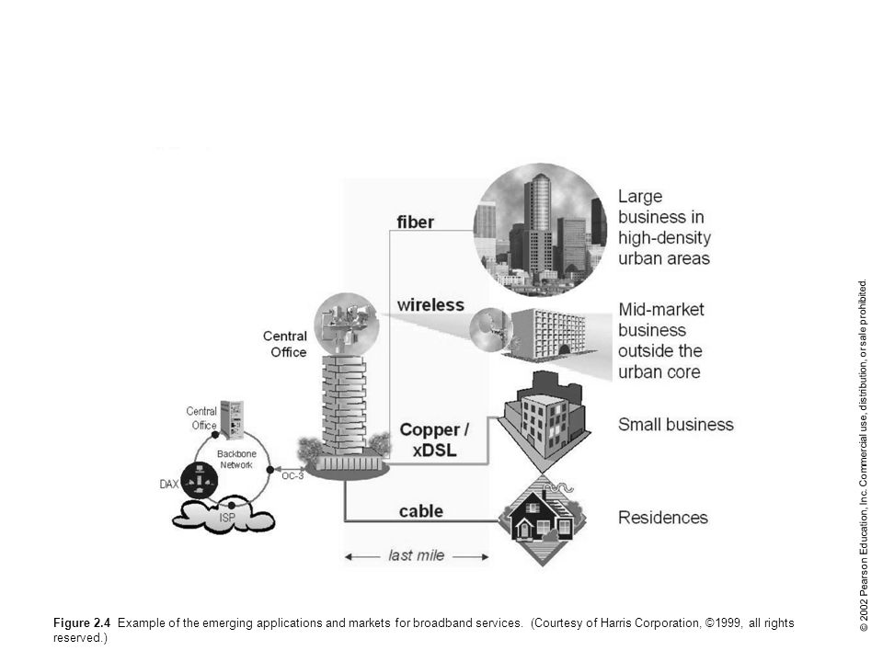

Slide 37
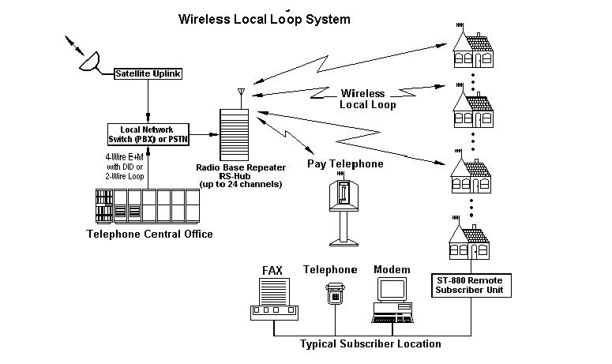

Slide 38
Local Multipoint Distribution Service
Provides broadband telecommunications access in the local exchange.
A brand new type of service in 1300MHz of unused spectrum.
Major application is in a Local Exchange Carrier (LEC) network.
Requires a LOS path (Using a millimeter wave fixed wireless link).

Slide 39
